Slide 2
Absence of Copyright
This slideshow contains photos, diagrams, and information, some of which were attained through internet searches of public websites. The author of this presentation does not own the copyright on this information, so this slideshow is for personal use only—not for sale or profit. Please utilize it to seek the Lord and grow in your knowledge of His Word and ways.
Bro Stan’s Revelation Study is available on our church website:
www.faithprinceton.org

Slide 4
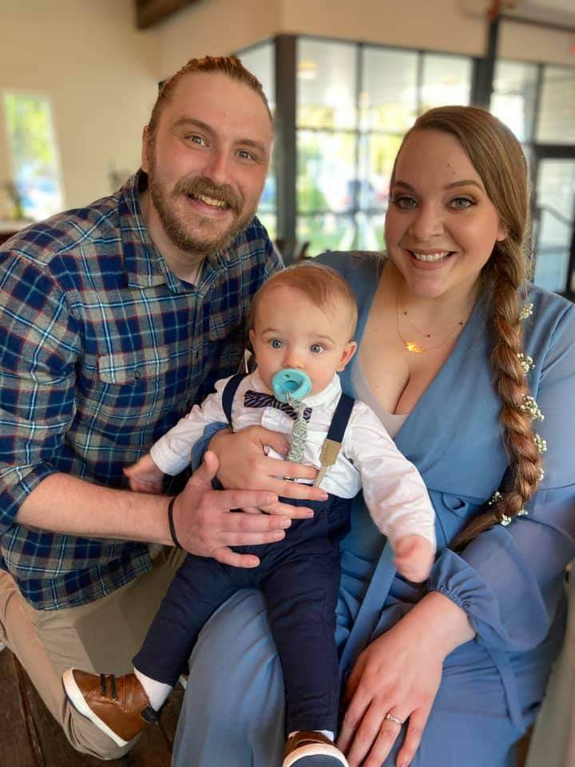
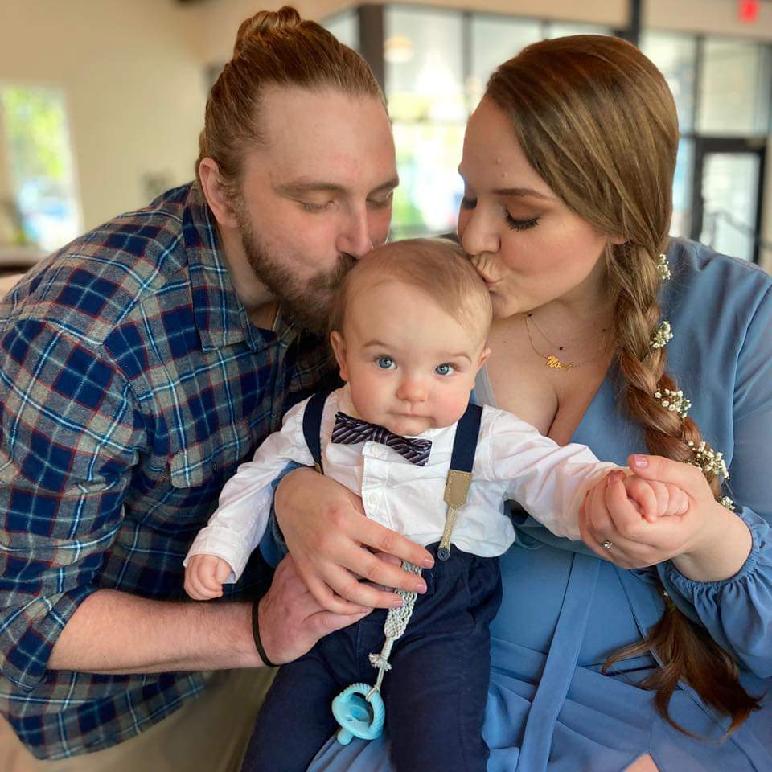
Noah’s first wedding

Slide 5
Prayer and Announcements
Sunday:
9:15 Small Group Sunday School Classes
(Kids class and nursery as well)
10:30 Worship

Slide 7
BEGIN HERE November 11, 2020
Week 25 – Revelation 17
The Doom of Babylon

Slide 8
Revelation 17 The Doom of Babylon
Notes:
Chapters 17 and 18 tell of the end of Babylon ➔ the center of world influence

Slide 9
Revelation 17 The Doom of Babylon
1 Then one of the seven angels who had the seven bowls came and spoke with me, saying, “Come here, I will show you the judgment of the great harlot who sits on many waters, 2 with whom the kings of the earth committed acts of immorality, and those who dwell on the earth were made drunk with the wine of her immorality.”
Notes:
One of the seven angels = this is a further explanation of something from the seventh bowl judgment:
See Rev 16:19 The great city was split into three parts, and the cities of the nations fell. Babylon the great was remembered in the sight of God, to give her the cup of the wine of His fierce wrath.
“Come here, I will show you the judgment of the great harlot who ➔ a harlot cheats on her lover, but also causes others to cheat on theirs
In this case, she led to the corruption of the world and its governments!!!
Archetype of wicked kingdoms such as Sodom, Egypt, Babylon, Tyre, Nineveh, and Rome. (Morris)
Jerusalem described as a harlot in Ezekiel 16 and 23; Babylon as a harlot in Jeremiah 51
sits on many waters, = vs 15 the waters are peoples and multitudes and nations and tongues
also described as sitting on the beast (v 3)
with whom the kings of the earth committed acts of immorality,
those who dwell on the earth were made drunk with the wine of her immorality.”

Slide 10
Revelation 17 The Doom of Babylon
3 And he carried me away in the Spirit into a wilderness; and I saw a woman sitting on a scarlet beast, full of blasphemous names, having seven heads and ten horns. 4 The woman was clothed in purple and scarlet, and adorned with gold and precious stones and pearls, having in her hand a gold cup full of abominations and of the unclean things of her immorality, 5 and on her forehead a name was written, a mystery, “BABYLON THE GREAT, THE MOTHER OF HARLOTS AND OF THE ABOMINATIONS OF THE EARTH.”
Notes:
Carried away in the Spirit into a wilderness???
??? Thought of a place away from the Lord... Dry and arid... SS lessons in Numbers ➔ A place of disobedience and lack of faith?
?? Rev 12:6, 14... the woman who gave birth to a son fled into the wilderness to be nourished and protected by God for 1,260 days.??
Has the church become the Harlot of Babylon???
scarlet beast, full of blasphemous names, having seven heads and ten horns ➔
same beast as in Revelation 13 and dragon in Revelation 12
Opposite of Jesus who rides a white horse and comes dressed in white with those who are faithful and true (Rev 19:8-14)
Blasphemous names ➔ another sign for us to know when the end times are drawing near... Blaspheming God!!!
Beautifully adorned but cup was filled with abominations and unclean things!!! ➔ ➔ picture...

Slide 11
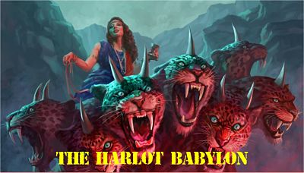
Notes:
Image from https://www.thelastdays.info/concurrent-events/the-harlot-Babylon
Rev Steve Evans
The woman John sees is a person of unparalleled depravity. If the beast she straddles stands for fierce, merciless brutality hell-bent on world conquest, this “great prostitute” represents fun-loving humanity going along for the ride. Where the beast is intense, humorless and driven by his dark purpose, the woman seems to recklessly live by the motto, “eat, drink and be merry for tomorrow we die.” Make no mistake, at heart she is just like the beast. A born deceiver, she paints herself fantastically as the playful image of a godless lifestyle. Her charms are alluring, but they’re all a mirage—like a harlot’s makeup or the thrill of intoxication. The ugly truth of her devotion to the beast and his ways is revealed by what makes her drunk: the blood of the saints (v 6).

Slide 12
Revelation 17 The Doom of Babylon
6 And I saw the woman drunk with the blood of the saints, and with the blood of the witnesses of Jesus. When I saw her, I wondered greatly. 7 And the angel said to me, “Why do you wonder? I will tell you the mystery of the woman and of the beast that carries her, which has the seven heads and the ten horns.
Notes:
Drunk with The blood of the saints... And witnesses (martyrs) of Jesus...
Early Christian readers would understand that whenever they were threatened with death by any temporal power—whether political, religious, or both—they were in reality facing the bloodthirsty mother prostitute whom God was about to judge and destroy once for all. (Morris, 270)
Wondered greatly ➔ lit. I wondered with great wonder OR I marveled with great marvel ➔ hard for even John to understand, but it fascinated him!
– properly, wonder at, be amazed (marvel), i.e. astonished out of one's senses; awestruck, "wondering very greatly" (Souter); to cause "wonder; . . . to regard with amazement, and with a suggestion of beginning to speculate on the matter“
Revelation 17:6; πρόσωπον, to admire, pay regard to, one's external appearance, i. e. to be influenced by partiality,
Why did you wonder? Marvel?
V 7 I will tell you... An explanation is coming.. But it still doesn’t answer all our questions...

Slide 13
Revelation 17 The Doom of Babylon
8 “The beast that you saw was, and is not, and is about to come up out of the abyss and go to destruction. And those who dwell on the earth, whose name has not been written in the book of life from the foundation of the world, will wonder when they see the beast, that he was and is not and will come.
Notes:
COUNTERFEIT GOD/RESURRECTION: WAS, IS NOT, WILL COME
The beast that you saw was, and is not, and is about to come up out of the abyss and go to destruction.
And those who dwell on the earth, whose name has not been written in the book of life from the foundation of the world,
TWO TYPES OF PEOPLE: EARTH DWELLERS vs. ETERNAL BOOK OF LIFE NAMES
will wonder when they see the beast, that he was and is not and will come.
Wonder ➔ marvel! Admire!

Slide 14
Revelation 17 The Doom of Babylon
9 Here is the mind which has wisdom. The seven heads are seven mountains on which the woman sits, 10 and they are seven kings; five have fallen, one is, the other has not yet come; and when he comes, he must remain a little while. 11 The beast which was and is not, is himself also an eighth and is one of the seven, and he goes to destruction. 12 The ten horns which you saw are ten kings who have not yet received a kingdom, but they receive authority as kings with the beast for one hour. 13 These have one purpose, and they give their power and authority to the beast.
Notes:
9 Here is the mind which has wisdom. THIS IS A CLUE!! TO UNLOCK THE MYSTERY!!
The seven heads are seven mountains on which the woman sits,
10 and they are seven kings
five have fallen,
one is,
the other has not yet come;
and when he comes, he must remain a little while.
11 The beast which was and is not, is himself also an eighth and is one of the seven, and he goes to destruction.
12 The ten horns which you saw are ten kings who have not yet received a kingdom,
but they receive authority as kings with the beast for one hour. ➔ LIMITED AMOUNT OF TIME!
13 These have one purpose, and they give their power and authority to the beast ➔ SINGLE PURPOSE – TO BE USED BY THE BEAST!
https://www.thelastdays.info/concurrent-events/the-harlot-babylon
The woman is not just seated on the beast, but upon the seven mountains he rules over. These might be geographic—the seven continents with their heads being the kings who rule over them. On the other hand, a good case can be made that these are the seven mountains of cultural influence and those who control them. Those high places of power in every society are religion, family, education, politics, business, arts and entertainment and the media.

Slide 15
Revelation 17:9-11 cont.
seven heads = seven mountains = seven kings
five have fallen
one is
the other has not yet come
when he comes, he must remain a little while.
11 The beast... is himself also an eighth and is one of the seven, and he goes to destruction.
Notes:
The beast has... seven heads are seven mountains on which the woman sits,
? Seven mountains = Rome was city built on seven hills [however, the woman seems to represent the city not the beast]
? Seven High Places = government, business, internet, religion, etc.
https://www.thelastdays.info/concurrent-events/the-harlot-babylon
The woman is not just seated on the beast, but upon the seven mountains he rules over. These might be geographic—the seven continents with their heads being the kings who rule over them. On the other hand, a good case can be made that these are the seven mountains of cultural influence and those who control them. Those high places of power in every society are religion, family, education, politics, business, arts and entertainment and the media.
10 and they are seven kings ➔ world kingdoms? ➔ Roman emperors?
five have fallen, [Egypt, Assyria, Babylon, Persia, Greece] ➔ 10 before Domitian? 9 from Christ death... Tiberius, Caligula, Claudius, Nero, 3 in one year, Vespasian, Titus, Domitian
one is, [Rome] ➔ Domitian
the other has not yet come; [last days empire? Future world kingdom?] ➔ Future revival of the Roman empire [several other emperors after John’s day]
and when he comes, he must remain a little while. [time, times and haf a time?]
11 The beast which was and is not, is himself also an eighth and is one of the seven, and he goes to destruction.
[Rev 13 the beast and false prophet set up a worldwide kingdom on behalf of the dragon]

Slide 16
Revelation 17:12-13 cont.
ten horns = ten kings
not yet received a kingdom
receive authority as kings with the beast for one hour
one purpose ... give their power and authority to the beast.
Notes:
12 The ten horns which you saw are ten kings who have not yet received a kingdom, [a ten kingdom coalition of nations? European Union? Muslim nations? Revived Roman empire?]
Ten is frequently a number to describe fullness (like seven)... A full amount of kingdoms will happen or Full strength of nations
but they receive authority as kings with the beast for one hour. ➔ LIMITED AMOUNT OF TIME! Beast is truly in control anyway!
13 one purpose ... give their power and authority to the beast.

Slide 17
Revelation 17 The Doom of Babylon
14 These will wage war against the Lamb, and the Lamb will overcome them because He is Lord of lords and King of kings; and those who are with Him are the called and chosen and faithful.”
Notes:
wage war against the Lamb, and the Lamb will overcome them = their purpose is the beast’s purpose ➔ to wage war against the Lamb! But they cannot win!!! The Lamb WILL overcome them!
because He is Lord of lords and King of kings; [Handel’s Messiah: The Hallelujah Chorus ends with King of Kings and Lord of Lords. Hallelujah.]
and those who are with Him are
the called ➔ expresses purpose?
and chosen ➔ emphasizes relationship?
and faithful ➔ expresses obedience?

Slide 18
Revelation 17 The Doom of Babylon
15 And he *said to me, “The waters which you saw where the prostitute sits are peoples and multitudes, and nations and languages. 16 And the ten horns which you saw, and the beast, these will hate the prostitute and will make her desolate and naked, and will eat her flesh and will burn her up with fire. 17 For God has put it in their hearts to execute His purpose by having a common purpose, and by giving their kingdom to the beast, until the words of God will be fulfilled. 18 The woman whom you saw is the great city, which reigns over the kings of the earth.”
Notes:
Waters = peoples, multitudes, nations, languages ➔ they all “support” the harlot ➔ mankind will unite into a common purpose of evil!!
V 16-17 the kings will turn on the prostitute and destroy her [religious fanaticism??? Terroristic holy war???]
Caird: “The ravaging of the whore by the monster and its horns is John’s most vivid symbol for the self-destroying power of evil.” (Morris, 275)
A KEY VERSE!!! ➔ 17 For God has put it in their hearts to execute His purpose by having a common purpose, and by giving their kingdom to the beast, until the words of God will be fulfilled.
V 18 ➔ woman = the great city ➔
the “archetype of every evil system opposed to God in history. Here kingdom holds sway over the powers of the earth.” (Morris, 275)
Occult religious system and influence of the AntiChrist kingom

Slide 19
END HERE November 11, 2020

